Slide 1
University of Basrah Al-zahra college of medicine
Ministry of higher Education and Scientific Research
Academic year 2021-2022
2nd year S-3
Cardiovascular Module
Session: Date: 5/1/2021
Lecture : shock
Module staff:
Dr Firas Rashid (Module leader) Dr Amed Bader (module co-leader) Dr Jawad Ramadhan Dr Nawal Mustafa Dr Mohammed Adil Dr Nehaya Al-Aubody Dr Amer Qasim Dr Hadeel S. Al Ali Dr Asaad Hassan Dr Hussain Abdul Ameer
Dr. Ammar Salih

Slide 2
University of Basrah Al-zahra college of medicine
Ministry of higher Education and Scientific Research
Learning Outcomes
By the end of lecture we should be able to:
1- define shock
2- classify shock according to stage and cause
3- know the clinical manifestation of shock
4- haemodynamic parameter changes in shock
5- Brief outline in management of shock

Slide 3
University of Basrah Al-zahra college of medicine
Ministry of higher Education and Scientific Research
Shock definition:
Shock is a life threating situation due to poor tissue perfusion with impaired cellular metabolism , manifested in turn by serious pathophysiological abnormalities (Baily and love).
Shock is a term used to describe the clinical syndrome that develops when there is critical impairment of tissue perfusion due to some form of acute circulatory failure (Davidson).
Shock maybe defined as inadequate delivery of oxygen and nutrients to maintain normal tissue and cellular function (Schwartz’s).

Slide 4
University of Basrah Al-zahra college of medicine
Ministry of higher Education and Scientific Research
Classification of shock:
Septic shock(distributive): results from bacteria multiplying in the blood and releasing toxins. Common causes of this are pneumonia, urinary tract infections.
Anaphylactic shock(distributive) is a type of severe hypersensitivity or allergic reaction. Causes include allergy to insect stings, medicines, or foods
Cardiogenic shock happens when the heart is damaged and unable to supply sufficient blood to the body. This can be the end result of a heart attack or congestive heart failure.

Slide 5
University of Basrah Al-zahra college of medicine
Ministry of higher Education and Scientific Research
Hypovolemic shock is caused by severe blood and fluid loss, such as from traumatic bodily injury, which makes the heart unable to pump enough blood to the body.
Neurogenic shock is caused by spinal cord injury, usually as a result of a traumatic accident or injury.

Slide 6
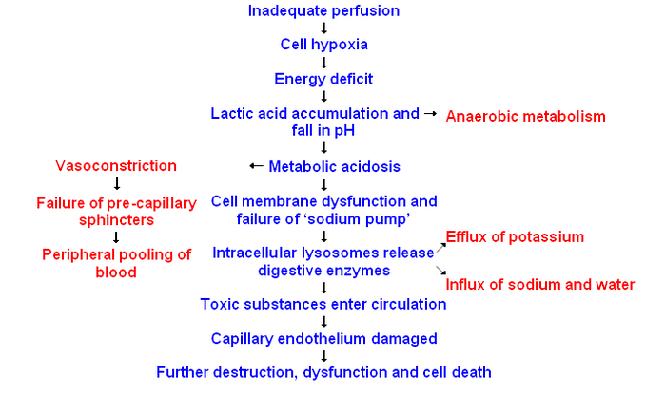
University of Basrah Al-zahra college of medicine
Ministry of higher Education and Scientific Research
Pathology of shock:

Slide 7
University of Basrah Al-zahra college of medicine
Ministry of higher Education and Scientific Research
Hypovolemic shock
Septic shock
Anaphlactic shock
Cardiogenic shock
↓ Effective circulatory blood volume
↓
↓ Venous return to the heart
↓
↓ Cardiac output
↓
↓ Blood flow
↓
↓ Supply of oxygen
↓
Anoxia
↓
Shock

Slide 8
University of Basrah Al-zahra college of medicine
Ministry of higher Education and Scientific Research
Stages of shock:
Deterioration of circulation in shock is a progressive and continuous phenomenon and compensatory mechanism become less effective.
Non progressive (initial, compensated , reversible) shock
Progressive decompensated shock
Irreversible shock

Slide 9
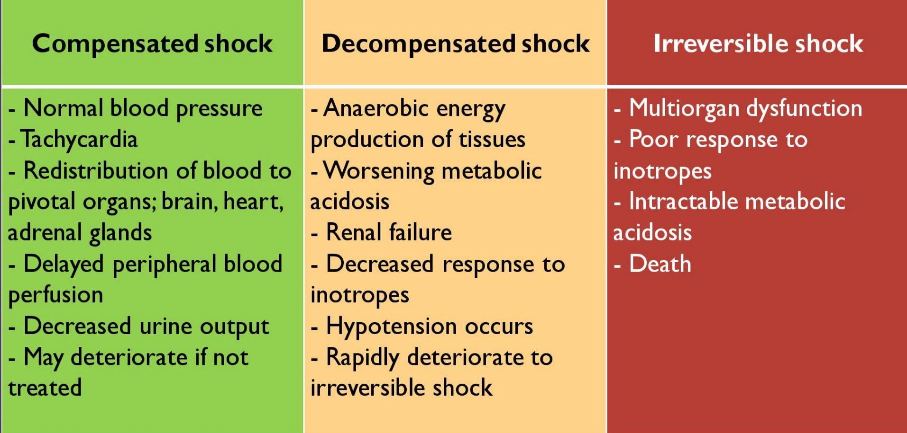
University of Basrah Al-zahra college of medicine
Ministry of higher Education and Scientific Research
Stages of shock:

Slide 10
University of Basrah Al-zahra college of medicine
Ministry of higher Education and Scientific Research
Haemodynamic parameter in different type of shock
Shock types | PAR | CO | SVR | preload
cardiogenic | ↑ | ↓ | ↑ | ↑
Distributive | ↓ | →↑ | ↓ | cause
Hypovolemic | ↓ | ↓ | ↑ | ↓

Slide 11
University of Basrah Al-zahra college of medicine
Ministry of higher Education and Scientific Research
Symptoms and sign of shock:
Dizziness
Lethargy
Cold extremities
Syncope
Feature of underlying disease process
Hypotension
Tachycardia
Rapid shallow respiration
Decrease urine output
MOF

Slide 12
University of Basrah Al-zahra college of medicine
Ministry of higher Education and Scientific Research

Slide 13
University of Basrah Al-zahra college of medicine
Ministry of higher Education and Scientific Research
Management :
Objective
Increase cardiac output
Increase tissue perfusion
The plan of action should be based on :
Primary problem
Adequate fluid replacement
Improving myocardial contractility
Correction acid base disturbances

Slide 14
University of Basrah Al-zahra college of medicine
Ministry of higher Education and Scientific Research
Haemorrhage
Control bleeding (compression, tourniquet, surgical haemostasis). Determine blood group.
Priority: restore vascular volume as quickly as possible
Insert 2 peripheral IV lines (2 catheters 16G in adults). Ringer lactate or 0.9% sodium chloride: replace 3 times the estimated losses and/or plasma substitute: replace 1.5 times the estimated losses.
Transfuse: classically once estimated blood loss represents approximately 30 to 40% of blood volume (25% in children).

Slide 15
University of Basrah Al-zahra college of medicine
Ministry of higher Education and Scientific Research
Severe anaphylactic reaction
Determine the causal agent and remove it.
Administer epinephrine (adrenaline) IM, into the anterolateral part of the thigh, in the event of hypotension, pharyngolaryngeal oedema, or breathing difficulties
Administer rapidly Ringer lactate or 0.9% sodium chloride.

Slide 16
University of Basrah Al-zahra college of medicine
Ministry of higher Education and Scientific Research
Septic shock:
Vascular fluid replacement with Ringer lactate or 0.9% sodium chloride or plasma substitute.
Use of vasoconstrictors:( dopamine ,epinephrine)
Look for the origin of the infection and administer antibiotic therapy according to the origin of infection.

Slide 17
University of Basrah Al-zahra college of medicine
Ministry of higher Education and Scientific Research
Cardiogenic shock
The objective is to restore efficient cardiac output. The treatment of cardiogenic shock depends on its mechanism.
Acute left heart failure with pulmonary oedema
Cardiac tamponade: restricted cardiac filling as a result of haemopericardium or pericarditis.requires immediate pericardial tap after restoration of circulating volume.
Tension pneumothorax: drainage of the pneumothorax.
Symptomatic pulmonary embolism: treat with an anticoagulant in a hospital setting.

Slide 18
University of Basrah Al-zahra college of medicine
Ministry of higher Education and Scientific Research
References:
1- Davidson 23rd ed. Text book of internal medicine
2- MKSAP 2018

Slide 19
University of Basrah Al-zahra college of medicine
Ministry of higher Education and Scientific Research
Thank you

